Slide 1
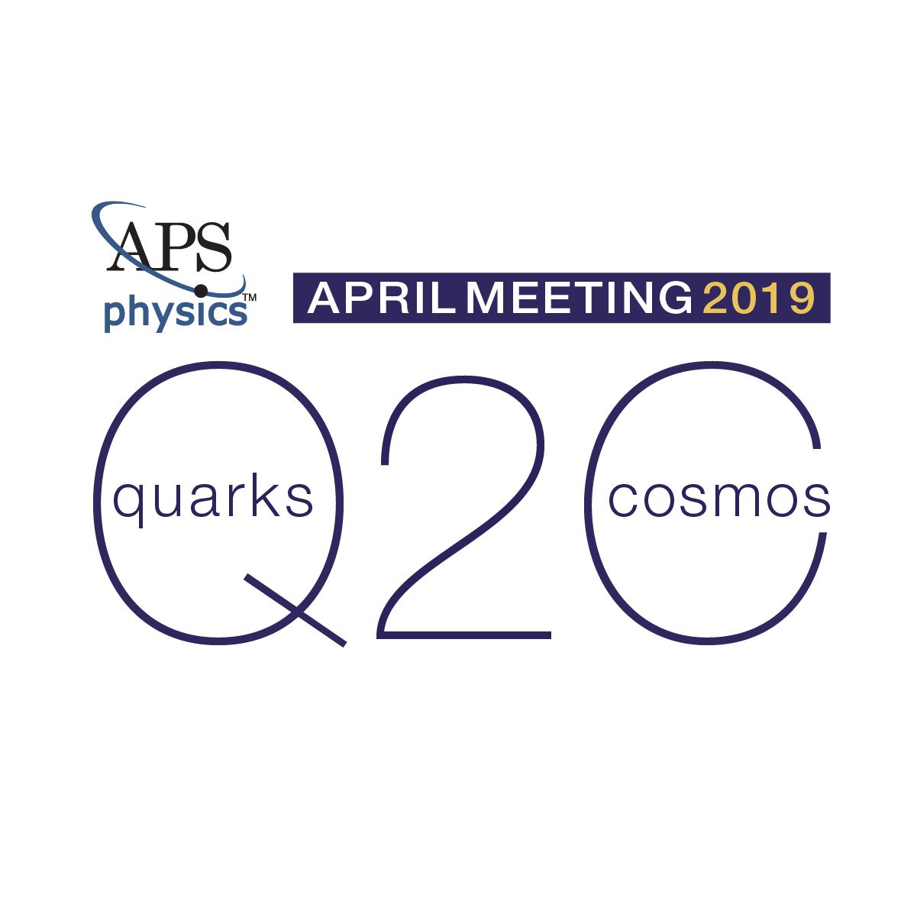
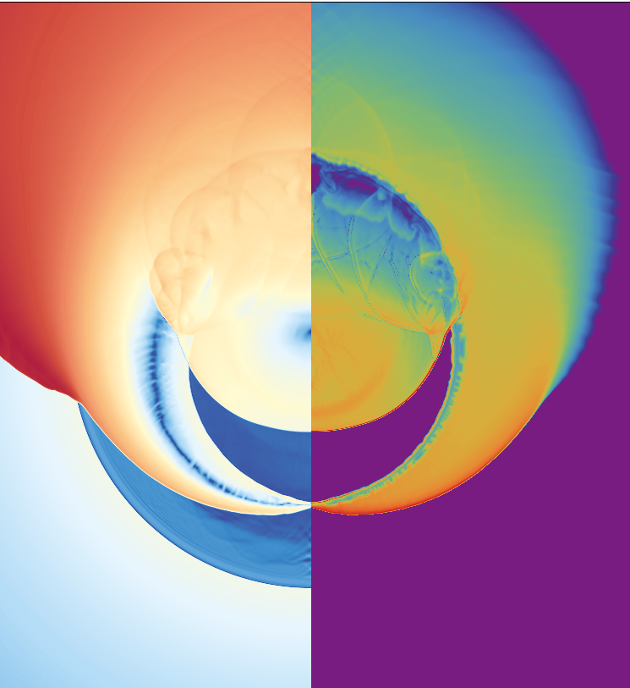
Nuclear Astrophysics Approaching the Exascale: Multi-physics Simulations of Stellar Explosions and Their Nucleosynthesis
Bronson Messer
Oak Ridge Leadership Computing Facility
Oak Ridge National Laboratory
&
Department of Physics & Astronomy
University of Tennessee, Knoxville
J. A. Harris¹, M. Sandoval², F. Rivas²,
T. Papatheodore¹, H. Klion^{3,1}
ORNL
UTK
UC Berkeley

Slide 2

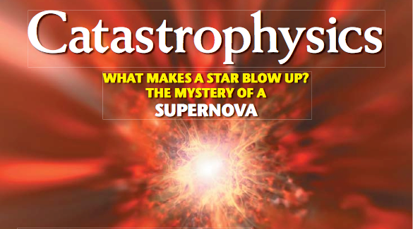
October 2006

Slide 3
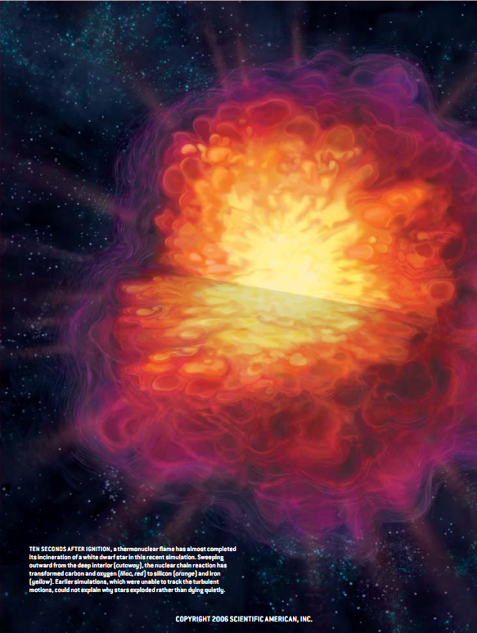
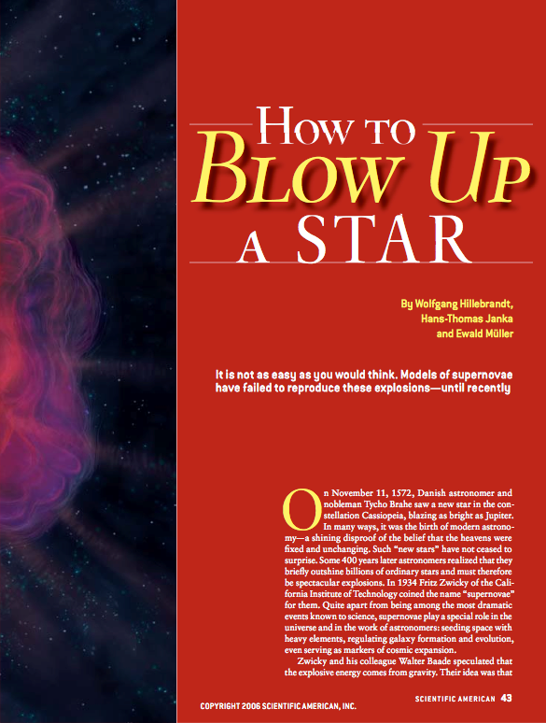

Slide 4
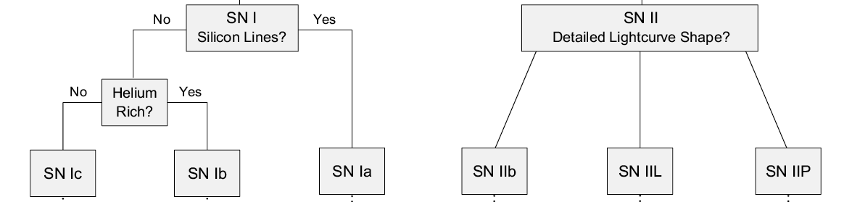
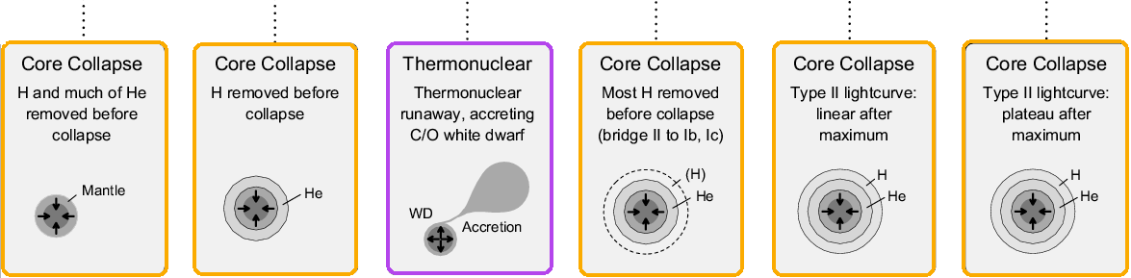
Supernova types
Notes:
astronomy old, like botany.. catalog and categoraize

Slide 5
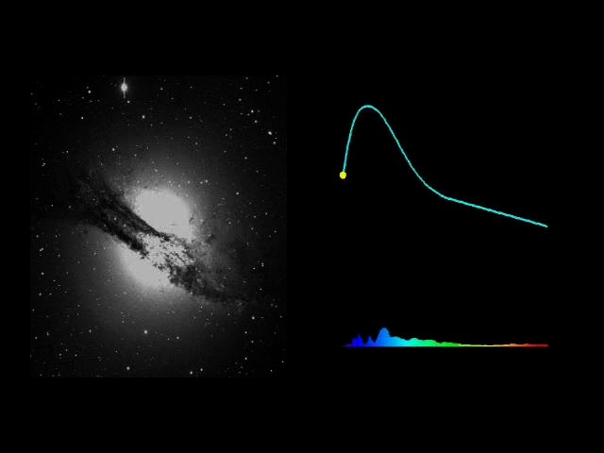
Type Ia supernovae
Brightness rivals that of the host galaxy (L ~ 10⁴³ erg/s)
Larger amounts of radioactive ⁵⁶Ni produced than in CCSNe
Radioactivity powers the light curve (“Arnett’s Law”)
Not associated with star-forming regions (unlike CCSNe)
No compact remnant - star is completely disrupted
Likely event − the accretion-induced thermonuclear explosion of a white dwarf
We’ll return to Sne Ia in just a little while, but…

Slide 6
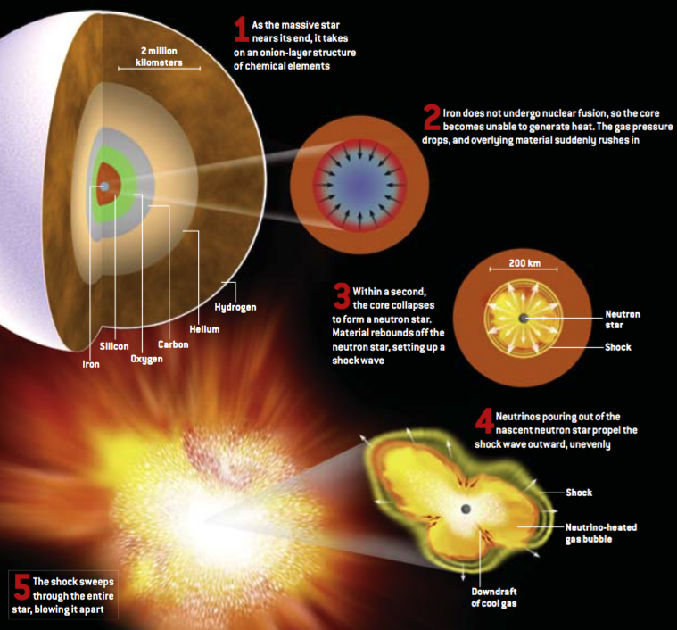
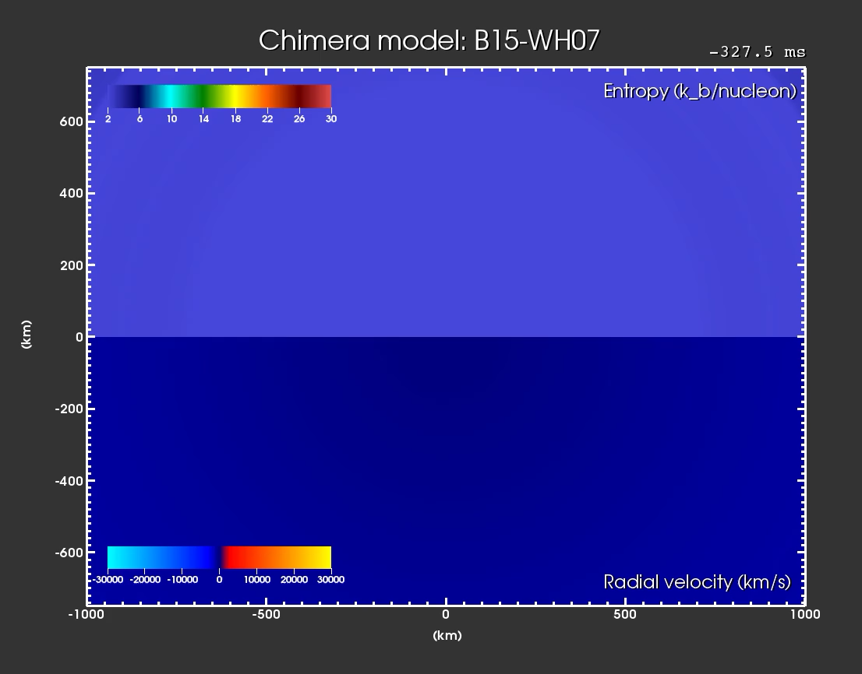
Core-collapse SNe
Hillebrandt, Janka, & Müller, SciAm (2006)

Slide 7
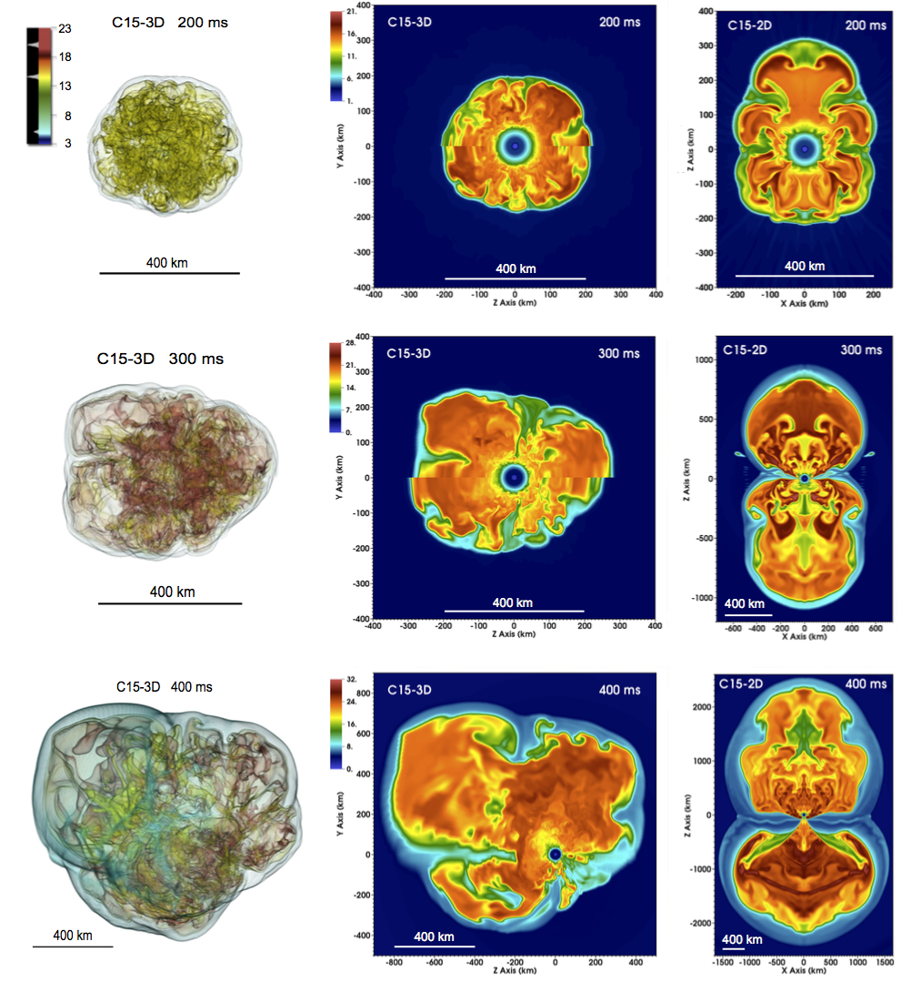
CCSNe (cont.)
Lentz, et al. (2015)
Similar amount of energy release compared to SNe Ia
Smaller amounts of radioactive ⁵⁶Ni produced than in SNe Ia
Compact remnant remains: either neutron star or black hole

Slide 8

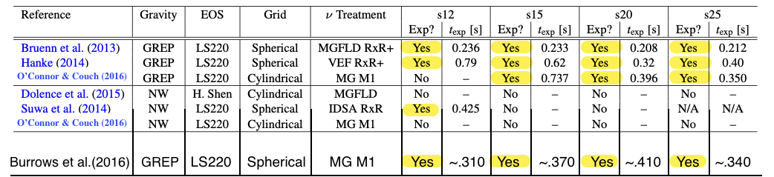
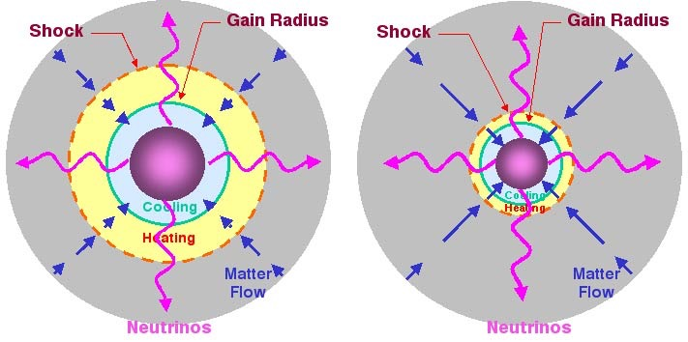
Modern multi-dimensional CCSNe sims routinely explode
adapted from O’Connor & Couch (2016)
GREP = GR effective potential
Newtonian
GR

Slide 9
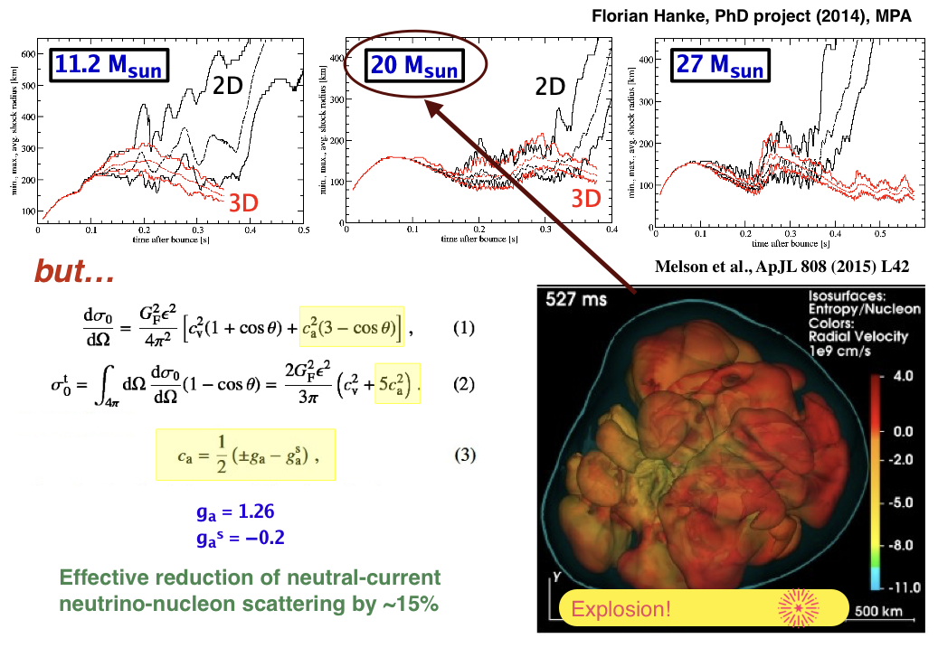
These 2D models have been joined by several exploding 3D models
Lentz+ (2015)
Vartanyan+ (2019)

Slide 10
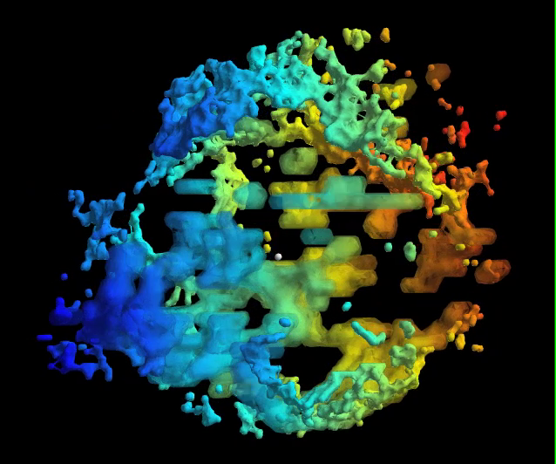
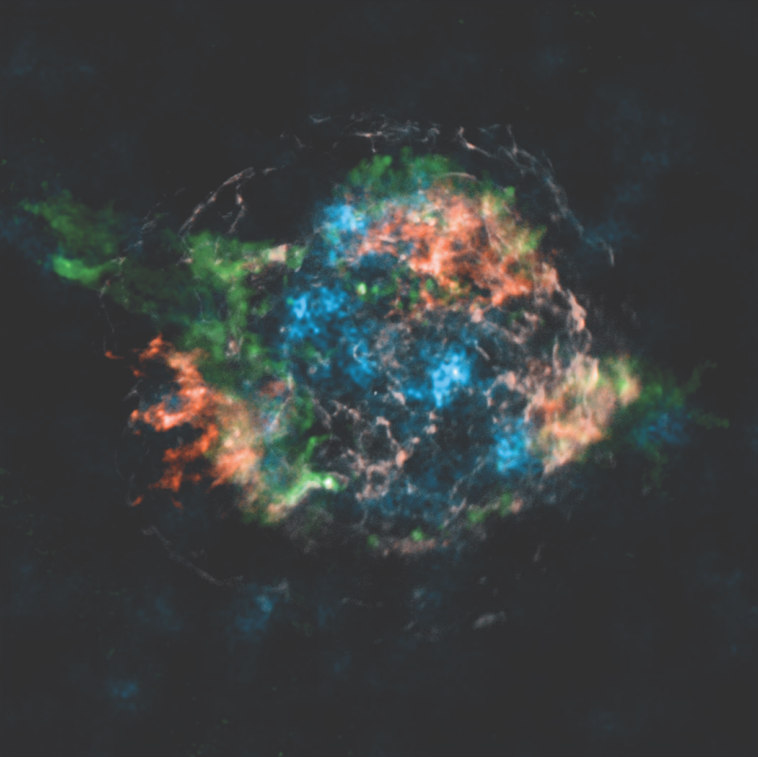
CCSNe in nature are 3D
Infrared: Sulfur
Beyond total yields, reconciling nucleosynthesis calculations and observations require following the explosion to the stellar surface (and beyond).
X-ray: Si/Mg, ⁴⁴Ti, Fe
Milisavljevic & Fesen (2015)
Interaction with the envelope, particularly the shell interfaces, continues to shape the ejecta.
Grefenstette+ (2014)
Notes:
So, I may have been begging the question slightly when I said earlier that multi-D CCSN nucleosynthesis is often overlooked: is CCSN nucleosynthesis really a multi-dimensional process?
Well, I think the answer is an unequivocal “yes”.
We’ve now been able to use high-energy X-ray observations of Titanium-44 decay with NuSTAR to support the tendency of the shock to favor low-order convective modes, or “slosh” in other words.
Other observations in the infrared of Sulfur reveal a bubble-like interior that also supports this idea of large-scale instabilities.
In both of these cases, observations of nucleosynthetic products produced by the explosion mechanism are probing the conditions of the central engine itself.
So, it is important for us to understand how these processes occur so we can make meaningful inferences about the explosion mechanism

Slide 11
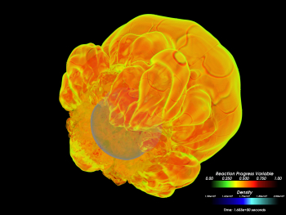
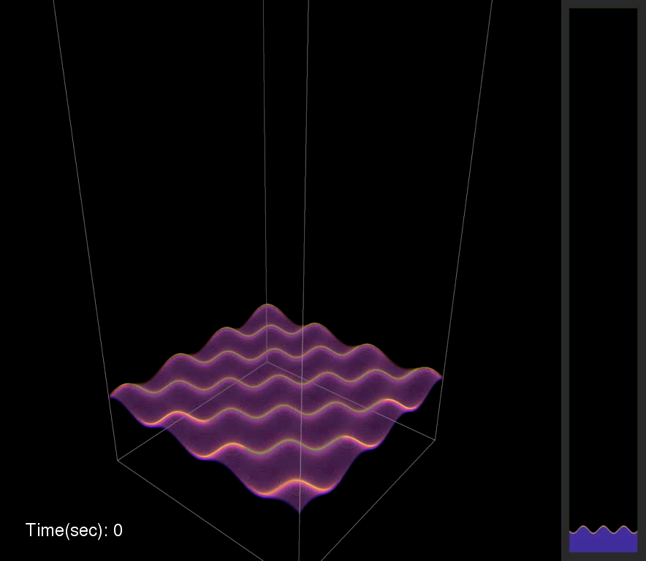
FLASH code
Component-based, MPI+OpenMP parallel, adaptive mesh refinement (AMR) code supporting:
  Directionally unsplit hydrodynamics
  Multipole gravity solver
  Nuclear burning network
  Stellar equation of state
  Turbulent flame interaction model
The code has been used to simulate a variety of phenomena:
  thermonuclear and core-collapse supernovae
  galaxy cluster formation
  classical novae
  formation of proto-planetary disks
  high-energy-density physics
FLASH is one of 13 codes chosen for the Summit Center for Accelerated Application Readiness (CAAR) at OLCF
Notes:
First I’ll provide a bit of an introduction to the code itself.
FLASH is a multi-physics, performance-minded, adaptive-mesh refinement code that supports an MPI+OpenMP programming model.
It’s architected in such a way to easily support multiple physics operations which may be interchanged.
Typically, the domain is decomposed into blocks assigned to individual MPI ranks and MPI-local physics operations use OpenMP to either thread over all local blocks or cells within each block.
The physics listed here are just a few examples that are relevant to the CAAR work targeting modeling thermonuclear supernovae.
But, FLASH is a widely adapted community code that has been used to study a variety of astrophysics and physics models, including …

Slide 12
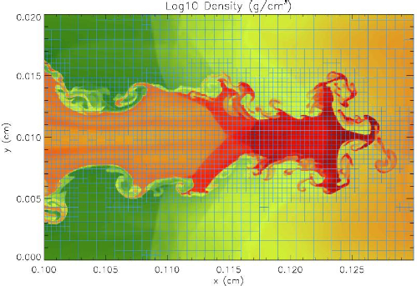
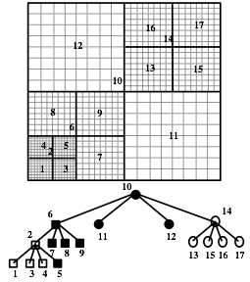
FLASH AMR
Currently uses octree-based PARAMESH (MacNeice+, 2000)
Moving to ECP-supported AMReX
Notes:
I’ll be referencing aspects of AMR in FLASH throughout the talk, so let’s establish some terminology:
FLASH currently uses an adaptive mesh framework called PARAMESH, but is being ported to use AMReX through an ECP project.
On the left is a simplified diagram of the oct-tree framework showing a simple set of blocks (outlined in bold) that cover a fixed domain.
The interior cells within the blocks are also shown---Each block here has 8 cells along each dimension.
In more refined regions the cell size is a factor of 2 smaller in each dimension when compared to its parent block, but each block has identically the same number of cells.
The numbers near the centers of each block indicate where that block falls in the ordered list of blocks, while the lower plot shows the resulting tree structure and the positions of each block.
On the right is an example of how this may be applied in a simulation such that we resolve the fine structures without over-resolving when it is not necessary.
This prevents us from wasting computation in regions of the domain where it is not needed.

Slide 13
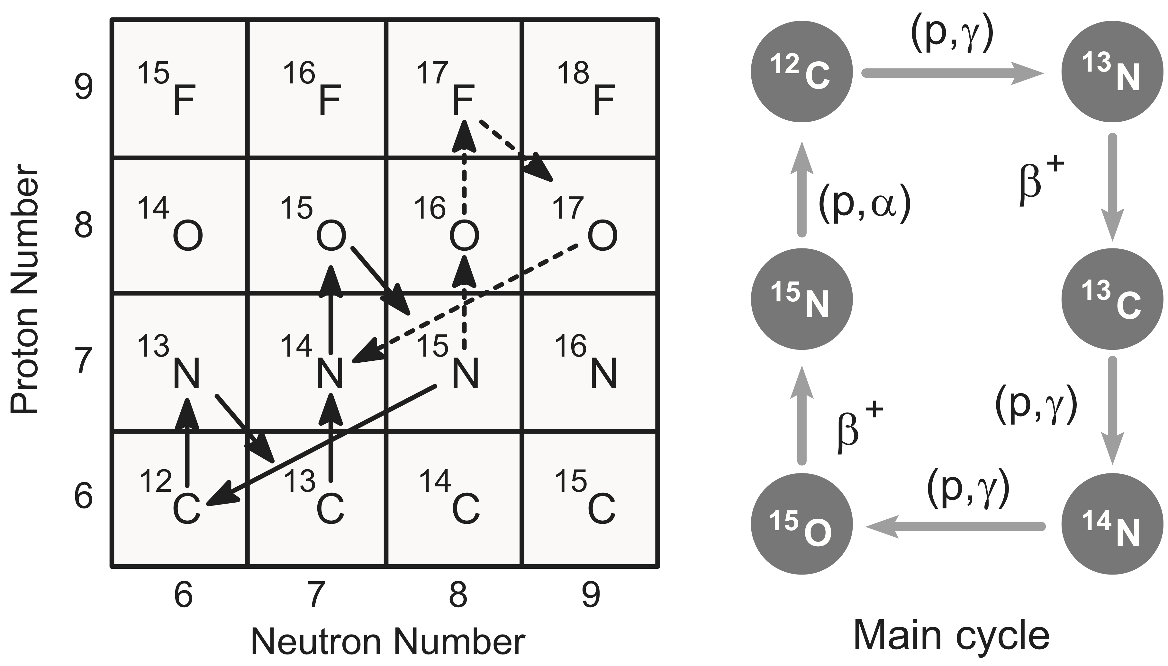
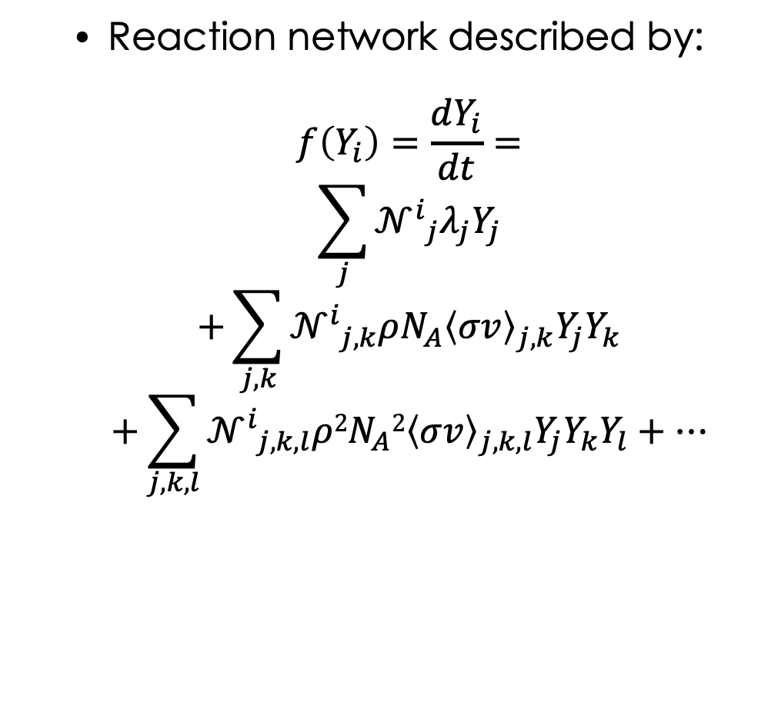
Nuclear kinetics
Reaction network described by:
$$f\left(Y_{i}\right)=\frac{dY_{i}}{dt}=$$
$$\sum_{j}{{𝒩^{i}}_{j}λ_{j}Y_{j}}$$
$$+\sum_{j,k}{{𝒩^{i}}_{j,k}ρN_{A}{\left\langle σv\right\rangle }_{j,k}Y_{j}Y_{k}}$$
$$+\sum_{j,k,l}{{𝒩^{i}}_{j,k,l}ρ{2N}_{A}2{\left\langle σv\right\rangle }_{j,k,l}Y_{j}Y_{k}Y_{l}}+…$$
Notes:
On top of the AMR framework, we compute MPI-local physics operations.
For the CAAR target problem, nuclear burning is the most important of these.
Energetically, it drives the explosion itself, but is also responsible for the synthesis of many of the intermediate mass elements like Silicon that we encounter in our daily lives.
As a brief overview of the physics itself, I’m showing a diagram of something called the CNO cycle that occurs in stars.
Each arrow in this chart represents a reaction that is transmuting one nuclear species into another.
This can occur through any combination of alpha, proton, or neutron captures and decays.
This basic description can be formalized into a rate of change in the abundance for a given nuclear species i.
The set of these equations describing a full nuclear composition constitutes a reaction network.

Slide 14
XNet
Stand-alone code for evolving arbitrary reaction networks
Originally designed to independently evolve particles/zones (SPMD)
  Minimal overhead for CPU shared-memory parallelism
  Unfortunately, not ideal for GPU
Primary focus of the FLASH CAAR project
  Replace small “hard-wired” reaction networks in FLASH with XNet interface and use programming model centered around GPU-optimized libraries
Notes:
To solve this problem, we had to incorporate some new physics capabilities in FLASH by interfacing with a reaction network code.
XNet is a code we use in multiple astrophysics codes, now including FLASH through work done for CAAR, to calculate the nuclear burning for an arbitrary reaction network.
It is a standalone code, written in modular Fortran.
Originally, XNet was designed to evolve each particle or zone in a calculation independently in a ”shared-program multiple data” paradigm.
This was good for shared memory architectures at the time because it minimized the overhead of spawning threads.
Unfortunately, this programming model has problems for the added complexity of using GPUs.
In fact, our approach for CAAR focuses on deconstructing the numerical operations used in XNet such that we can take advantage of GPU-optimized libraries.

Slide 15
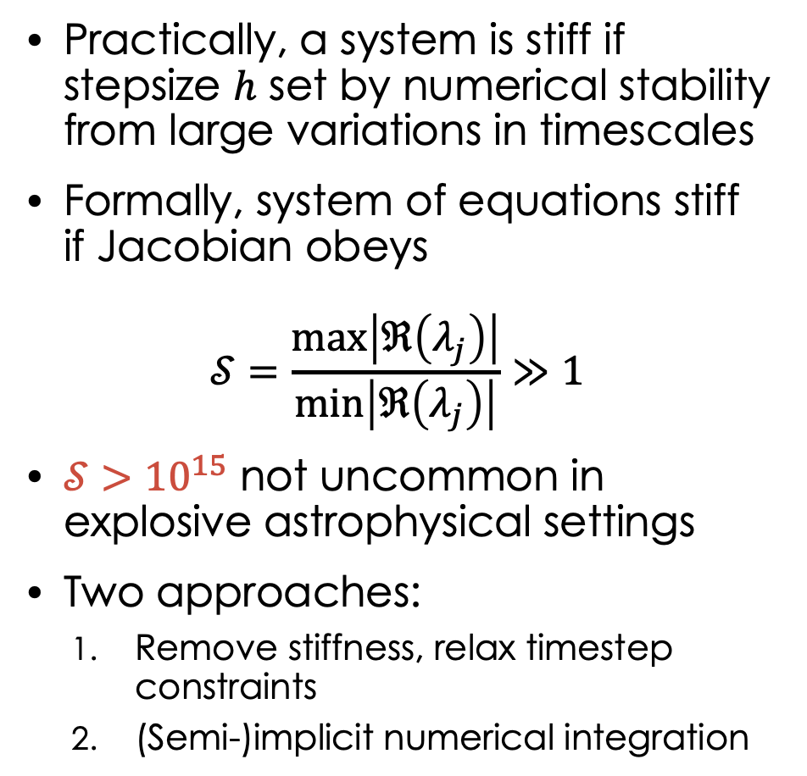
A digression on stiffness
Practically, a system is stiff if stepsize $h$ set by numerical stability from large variations in timescales
Formally, system of equations stiff if Jacobian obeys
$$𝒮=\frac{max\left|ℜ\left(λ_{j}\right)\right|}{min⁡\left|ℜ\left(λ_{j}\right)\right|}≫1$$
$𝒮>{10}^{15}$ not uncommon in explosive astrophysical settings
Two approaches:
  Remove stiffness, relax timestep constraints
  (Semi-)implicit numerical integration
Notes:
Before continuing, it’s important that I take a minute to digress on the topic of numerical stiffness.
Loosely, stiffness is a property of a system of equations that can be characterized by contributions to its evolution from components with largely varying timescales.
Practically, this means that a system is stiff if the stepsize is set by considerations of numerical stability rather than accuracy.
A more rigorous definition of stiffness posits that a system is stiff if the ratio of the maximum and minimum real components of eigenvalues of the Jacobian is much greater than one.
There are basically two approaches to dealing with stiffness.
Either, one can try to effectively remove the stiffness through some equilibrium approximations and relax the constraints on the stepsize,
Or, one can utilize an implicit or semi-implicit numerical method.
Computationally, this is important because it means we must now compute solutions to large linear systems with matrices.

Slide 16
Notes:
To illustrate the demands for the targeted CAAR problem, I’m showing here the maximum mass fractions attained by a much larger reaction network as it burns in conditions typically encountered in a Type Ia supernova.
We have found that a 231-species network, outlined in red, is needed to accurately simulate to the targeted problem.
This is a substantial increase in computational demand over the standard 13 species, marked by the white alpha-symbols.
On a CPU, we might see some small benefit from using a sparse solver, but this size of a network is very near the breakeven point.
On the GPU though, we are currently left with using a dense linear solver for this system.

Slide 17
Reaction networks
Number of evolved species
10
100
1,000
Big Bang nucleosynthesis
Stellar
evolution
Supernovae
(TNSN)
Supernovae
(CCSN)
Supernovae
(ECSN)
X-ray
bursts
Neutron-star
Mergers
Physical fidelity
FLOPS
Sparsity
Batched, dense solvers for GPUs are key to accelerating these computations.
Notes:
This constraint to implicit methods becomes a limiting factor for scaling reaction networks to more species.
As the number of species is increased and additional reaction pathways made available to the network, we quickly become limited in the tractable science problems we can solve, since the computational expense to solve these systems grows quite rapidly.
Fortunately, the systems become more sparse as they grow in size, but still they do not see much benefit from sparse solvers until more than 200-300 species.

Slide 18
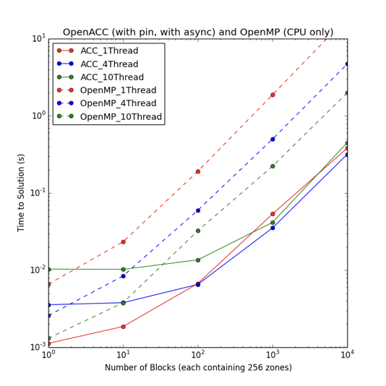
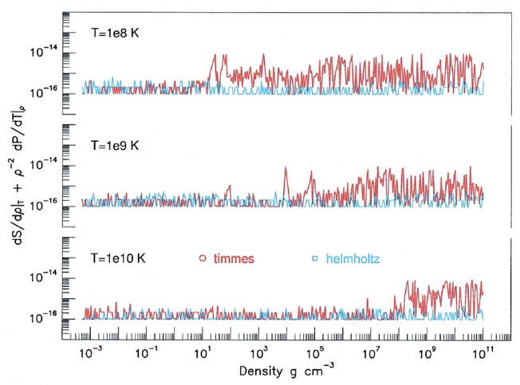
More acceleration – equation of state
Helmholtz EOS
High-order interpolation from table of free energy (quintic Hermite polynomials)
Messer&Papatheodore (2017)

Slide 19
FLASH AMR Optimization
Problem: Computational load can be quite unevenly distributed
  Nuclear reaction rates are highly temperature dependent
Solution: Weight the Morton space-filling curve according to the number of burner sub-timesteps required per block
  ~1.5x speedup at scale
Notes:
There’s on more ingredient we need to include for multi-node FLASH performance.
With a small reaction network, the load imbalance in the network is small compared to the cost of hydrodynamics and other operations.
For these cases, the overall workload is evenly distributed across the MPI ranks and an equally weighted Morton-space filling curve is used.
This assigns AMR blocks to MPI ranks in a way that prioritizes keeping communication costs between blocks for guard-cell fills low.
For bigger reaction networks, the computational load can become unbalanced, even with the new network solver.
This requires us apply some weighting function to the space-filling curve that attempts to evenly distribute the work being done.
We still need to be mindful about communication costs though, and being overly aggressive to achieve a balanced load for the burner results in worse performance than no weighting.

Slide 20
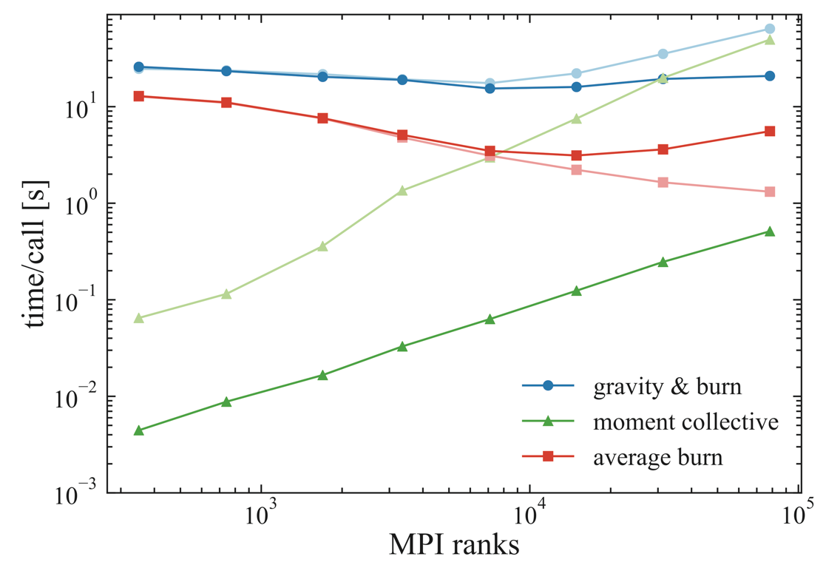
Multipole gravity solves using non-blocking communication
Blocking
Overlapping collective communication during the multipole gravity solve with the accelerated nuclear kinetics
Removes the primary impediment to scalability at large rank counts
Non-blocking
Klion+ (2017)

Slide 21
Putting it all together: FLASH scaling results
Real physics problem:
  Centrally detonated white dwarf with 231 species
  Nearly ideal weak scaling to ~1000 nodes
Notes:
This allowed us to proceed with our CAAR scaling metric for Summit.
We centrally ignite a white dwarf and track 231 nuclear species after the explosion has evolved for a little bit.
This gives a more representative sample of the simulation than if we were to start from time 0.
On the right, I’ve plotted the walltime taken per step normalized to the number of nodes.
This is a weak scaling plot, so as the number of nodes increases, the amount of work is also increased by adding more zones by way of adding additional levels of refinement.
For this problem, FLASH scales nearly perfectly to about 1300 nodes.
Also, as you can see in the plot on the left, we’re getting roughly 3x speedup using the GPU relative to the CPU only code.

Slide 22
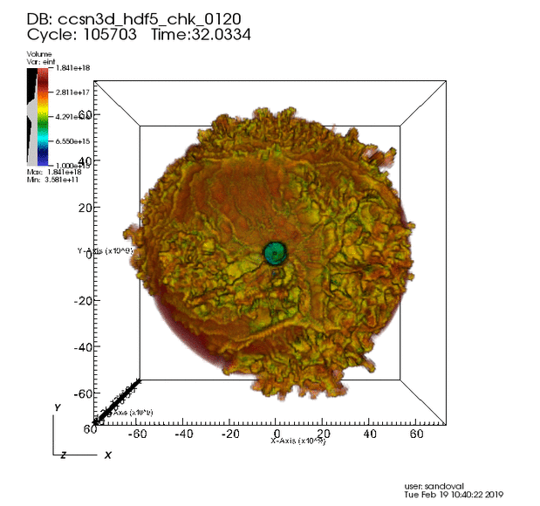
Hot off Summit: Extended CCSNe sims
Sandoval et al. (in prep)
OLCF Early Science
SN160 network
  Full RadHydro simulation(Chimera) remapped at 0.466 s to FLASH AMR grid
    GPU-accelerated burner back-ported from FLASH to Chimera
  Burning while any appreciable energy release present on the grid
  Composition carried for the full 17 hours

Slide 23
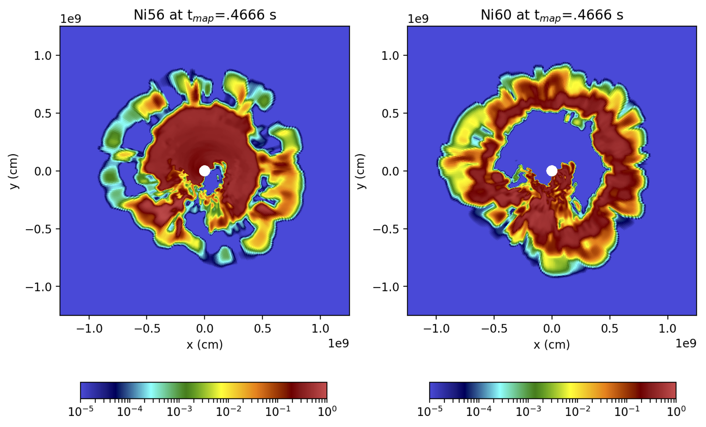
Hot off Summit…
Sandoval + (in prep)
Summit Early Science

Slide 24
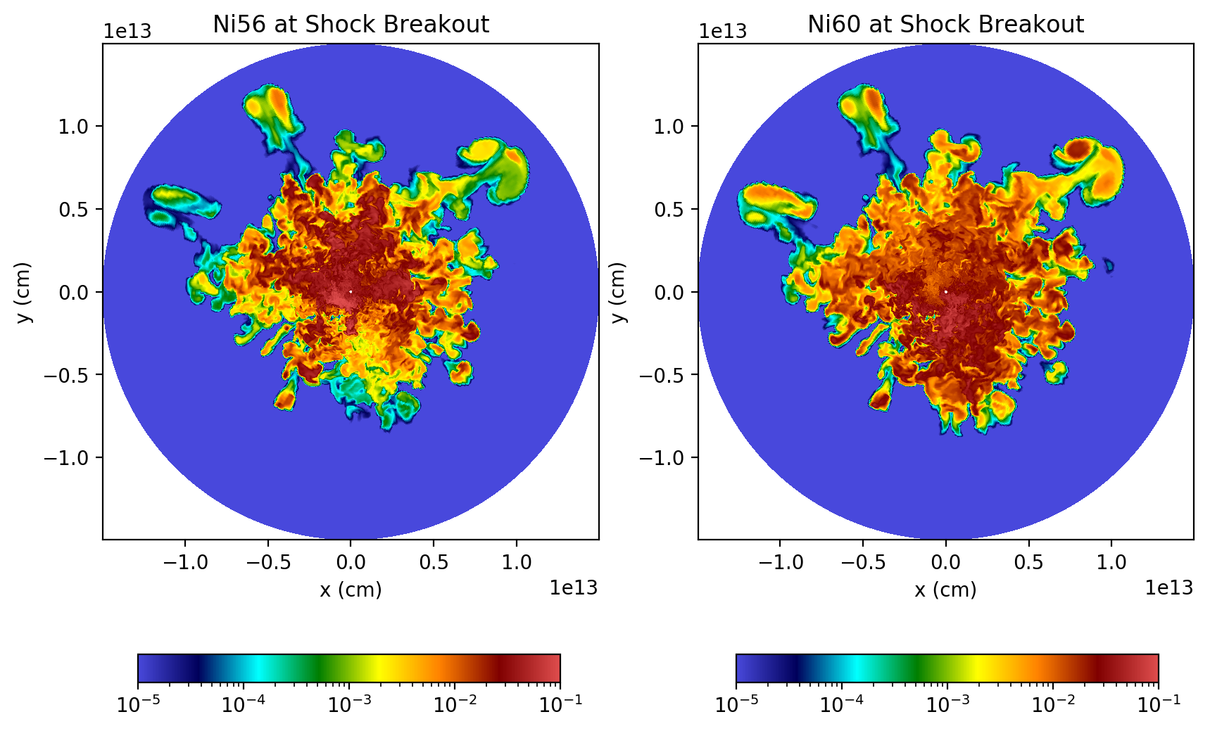
Hot off Summit…
Sandoval + (in prep)
Summit Early Science
17 hours later, 10,000 times bigger

Slide 25
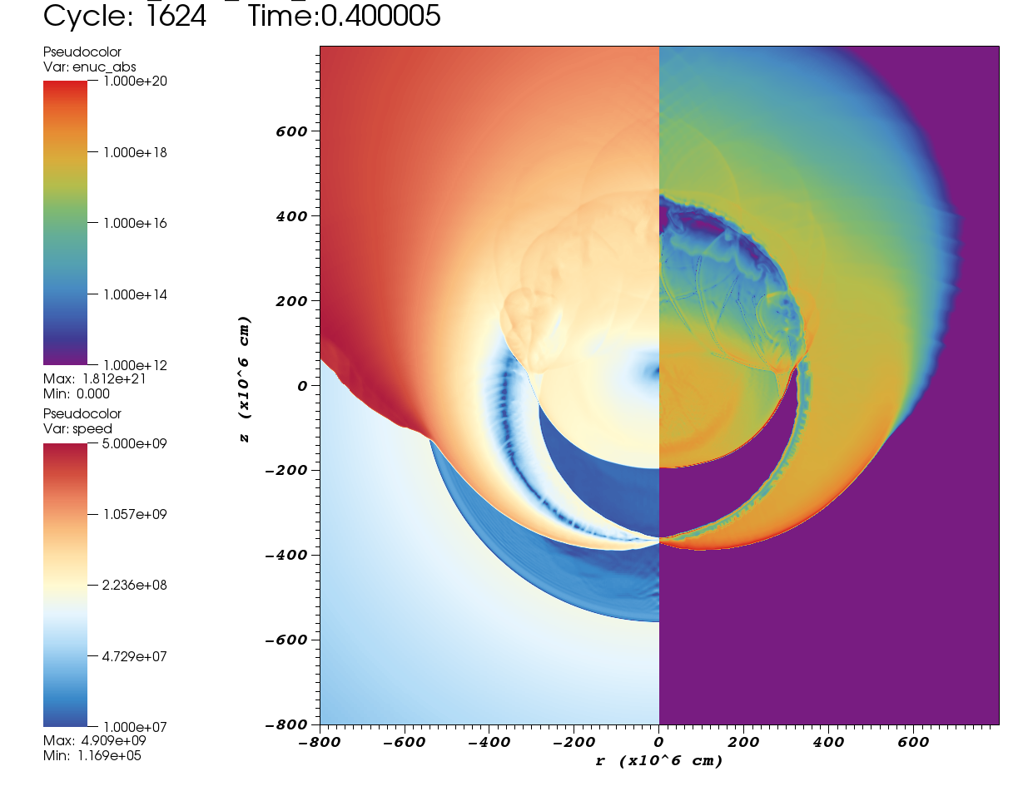
As promised, back to SNe Ia…
2D simulations performed in preparation for a large 3D simulation on Summit
  In 2D, we largely reproduce the results of Townsley+ (2019) and Fink+ (2010).
3D at higher resolution with 231-species network via Summit Early Science – stay tuned!
Rivas+ (in prep)
Townsley+ (2019)
Notes:
Townsley et al is 4km resolution
Fink et al. is about 8km, but is not AMR
Ours is 8

Slide 26
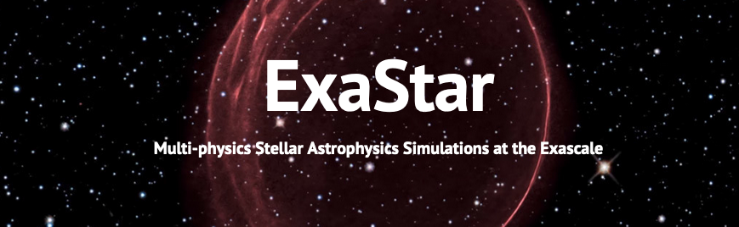









Daniel Kasen, Ann Almgren, Don Wilcox, Wick Haxton (LBNL)
Philipp Mösta, Ken Shen (Berkeley)
Bronson Messer, Raph Hix, Eirik Endeve, Anthony Mezzacappa, Austin Harris, Ran Chu, Eric Lentz, Michael Sandoval, Fernando Rivas (ORNL/UTennessee)
Sean Couch, Michael Pajkos, Jennifer Ranta (Michigan State)
Anshu Dubey, Saurabh Chawdhary, Carlo Graziani, Jared O’Neal (ANL)
Klaus Weide (UChicago)
Mike Zingale, Xinlong Li (Stony Brook)

Slide 27
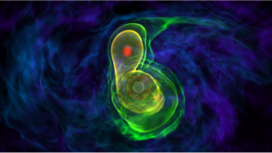
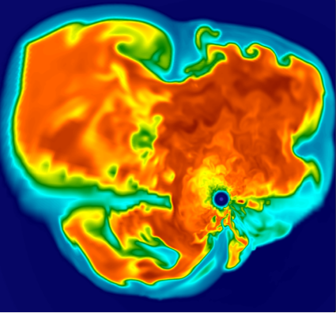

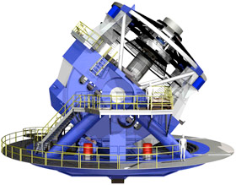

ExaStar simulations are essential to:
    Guide future nuclear physics experimental programs
      siting the r-process directly impacts which rates are most important to measure
    Provide reliable templates for gravitational wave and neutrino detectors
      Low signal-to-noise requires templates for matching
    Interpret X-ray and gamma-ray observations
ExaStar simulations will have connections to:
  experimental nuclear physics data
  satellite observations of astrophysical phenomena
  GW detections
  neutrino experimental data, including solar and reactor experiments to improve predictive power
LIGO

Slide 28
reactions
ExaStar
multiphysics
dynamics
Nuclear Reaction Networks
sparse stiff linear systems
Compressible Hydrodynamics
Finite Volume Godunov methods
Lagrangian tracer Particles
for post-processing
magnetohydrodynamics
block-structured adaptive mesh
refinement
Two-moment Transport
Semi-implicit Discontinuous Galerkin methods
Boltzmann Transport
Implicit Monte Carlo methods
Approximate relativity
Conformally flat approx.
Elliptic eq w/ multigrid methods
radiation
Full general relativity
DG methods for Einstein Eq.
Equation of State Module
local, tabulated
radiation transport
will be >90% of all
FLOPs in
challenge problem
gravity
Opacity Module
tabulated, scattering kernels
microphysics

Slide 29
Summary
A GPU-enabled FLASH code on Summit is capable of performing high-fidelity reactive flow calculations of supernovae that allow us to directly confront observations.
This OLCF CAAR-enabled work is being directly fed into ECP (ExaStar) development on FLASH/CLASH.
Exascale aim: Produce high-fidelity, fully coupled simulations of supernova explosions and neutron star mergers that can be directly compared to observations of photons, neutrinos, and gravitational waves from these explosive events.
This research used resources of the Oak Ridge Leadership Computing Facility at the Oak Ridge National Laboratory, which is supported by the Office of Science of the U.S. Department of Energy under Contract No. DE-AC05-00OR22725.

