Slide 1
First Principles Calculations of the Equation of State of MgSiO₃ in the Gigabar Regime
PIMC + DFT
Felipe González
Francois Soubiran, Henry Peterson, Burkhard Militzer
University of California, Berkeley
4/9/2019
Notes:
Hello everyone. My name is FG. Postdoc at UCB
And today I want to share with you results we have obtain in collaboration with BM from FPMD of MgSiO3

Slide 2
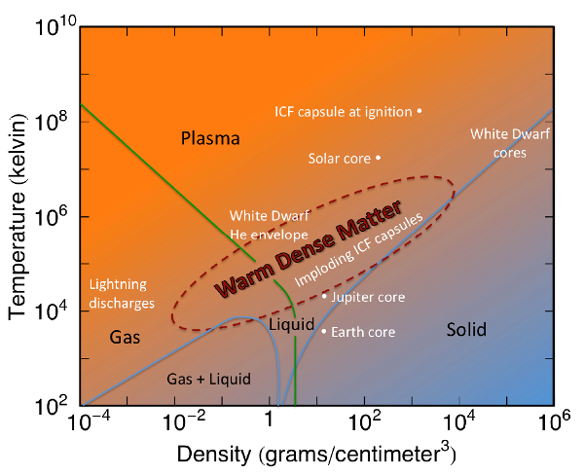
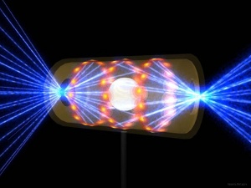
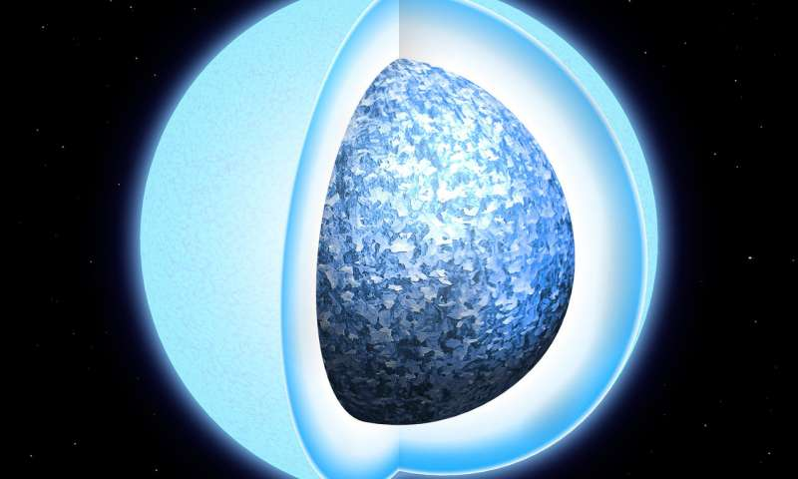
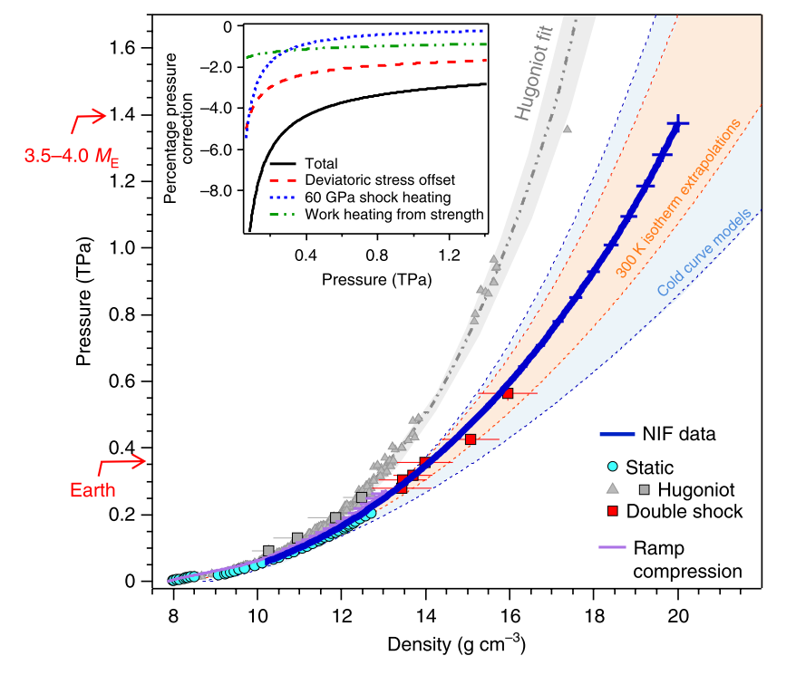
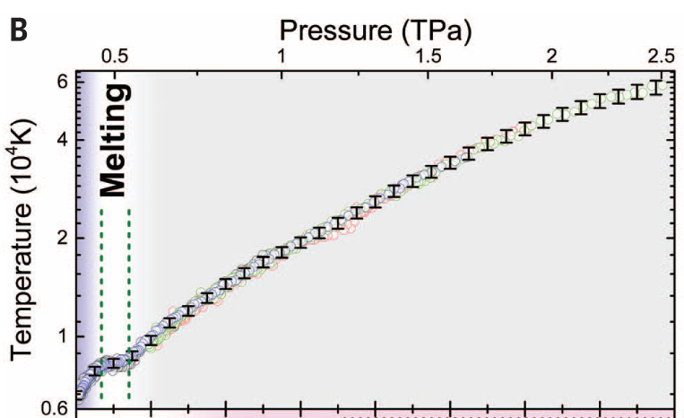
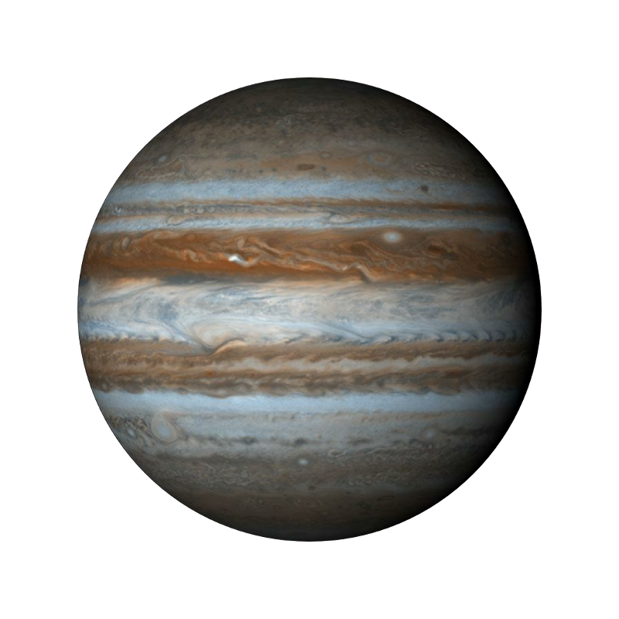
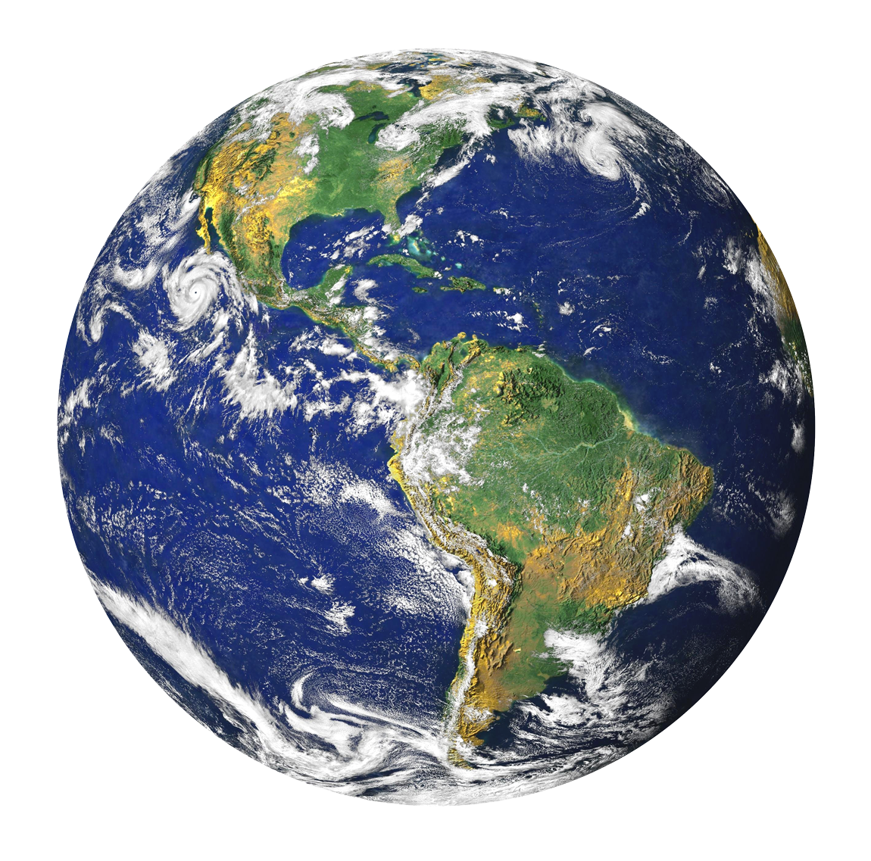
Warm Dense Matter
Exoplanet interiors
Neutron stellar atmospheres
Inertial confinement fusion (NIF, OMEGA, LIL)
MgSiO₃
Fe
SiO₂
Millot et al., Science 2015
https://www.lanl.gov
Smith et al., Nat. Ast 2018

Slide 3
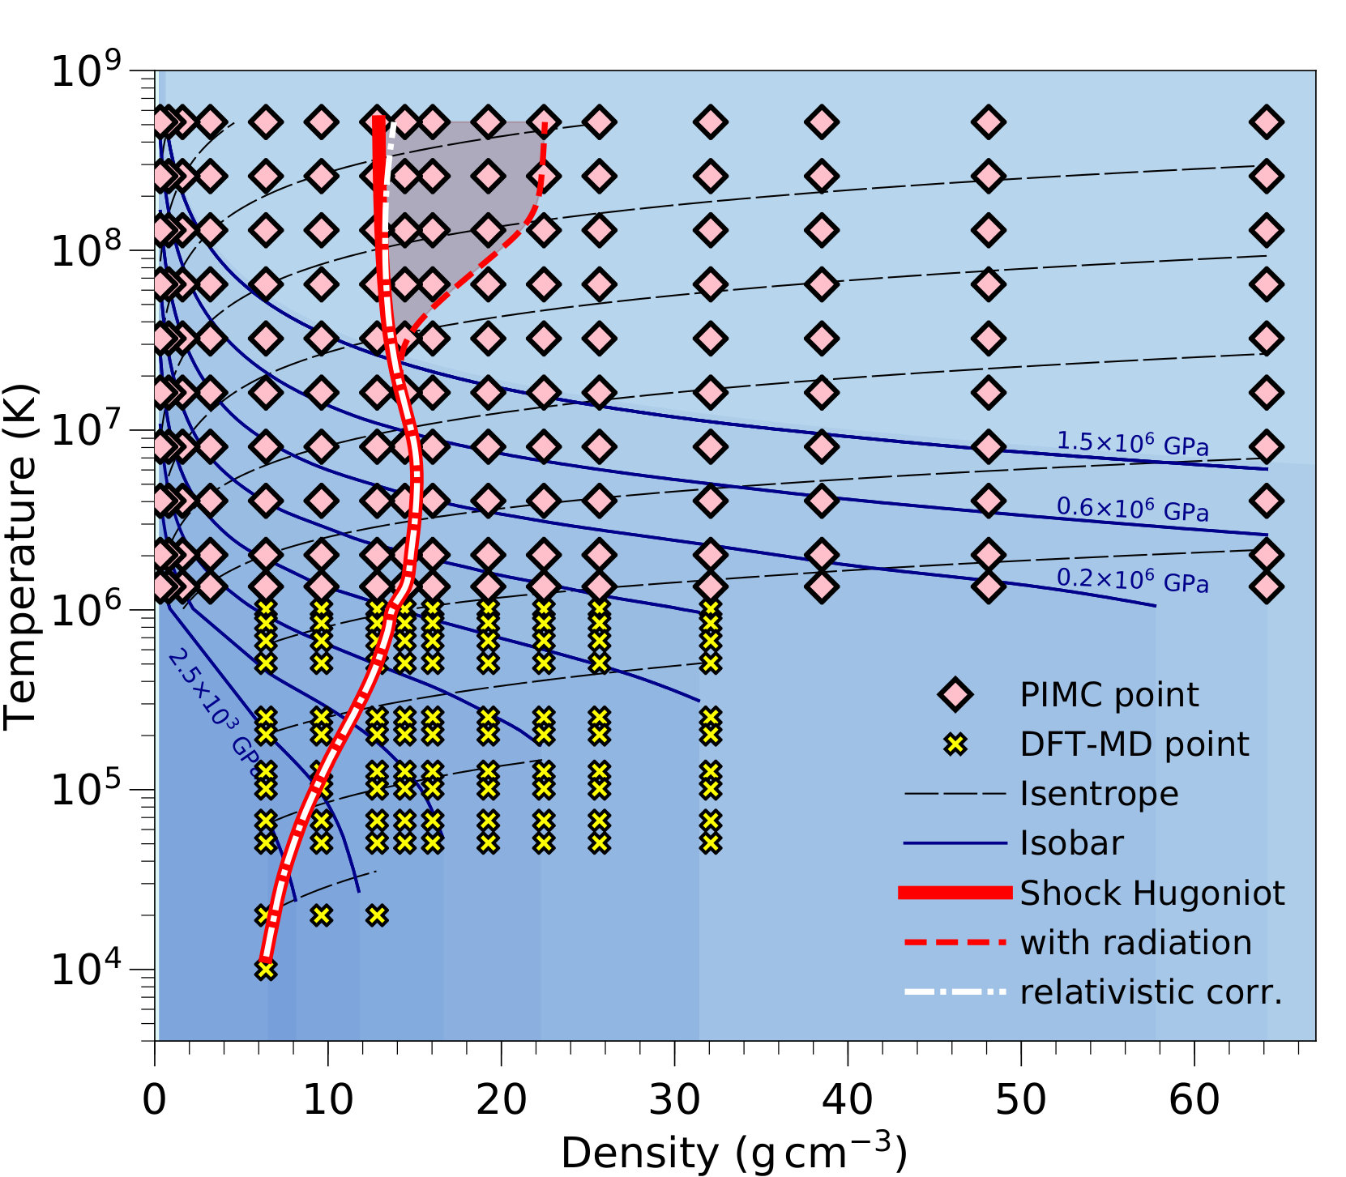

Warm Dense Matter
0.1−fold to 20−fold
DFT-MD
PIMC

Slide 4
OUTLINE
Motivation
Computational Techniques
  Path Integral Monte Carlo (PIMC)
  Density Functional Theory Molecular Dynamics (DFT-MD)
EOS and Hugoniot curves
Ionization
Atomic structure
Conclusions and Implications

Slide 5

Path Integral Monte Carlo
Density Functional Theory
Kohn-Sham equations
XC Func. : LDA / GGA
Pseudopotentials (frozen cores)
ALL ELECTRON

Slide 6
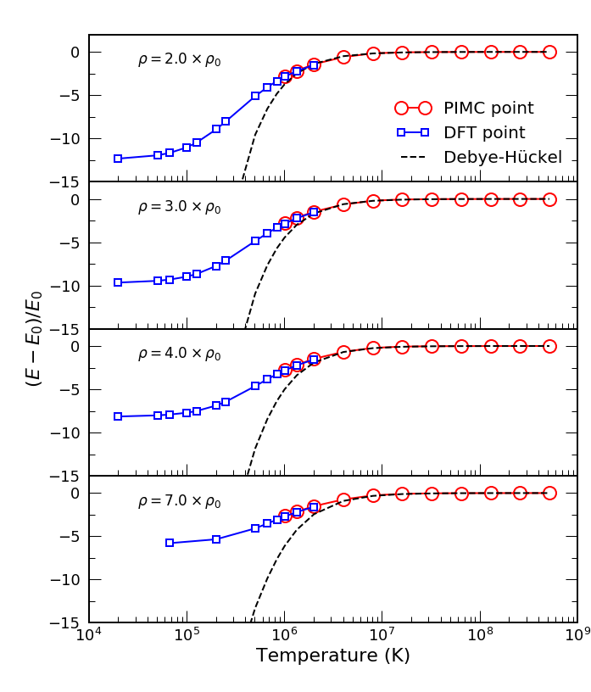
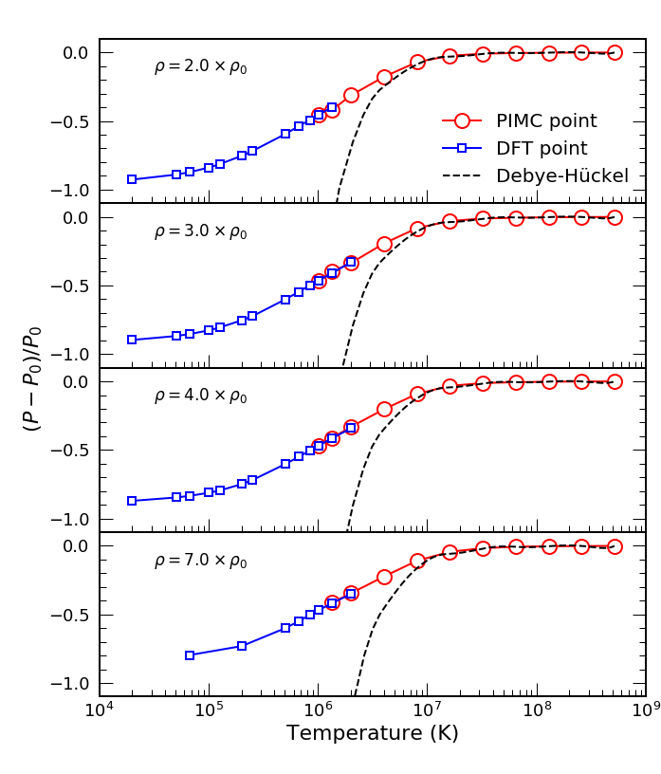
Consistent EOS: PIMC + DFT

Slide 7
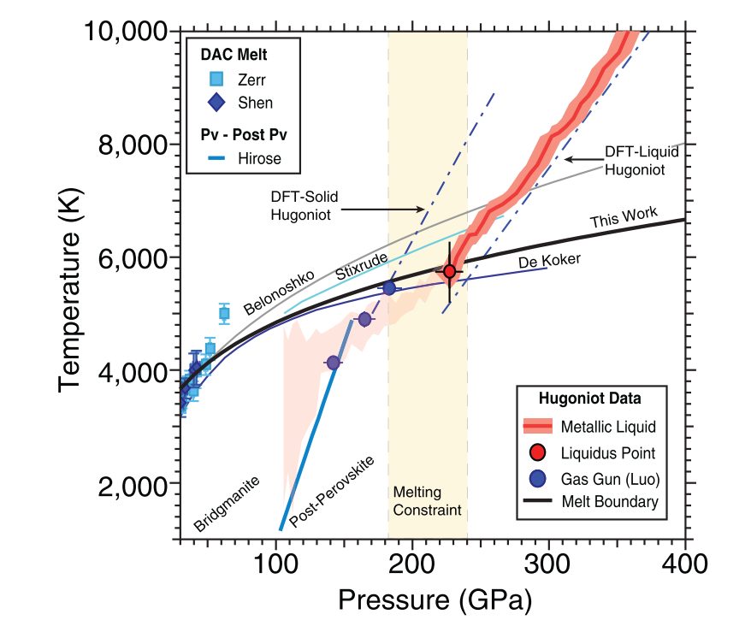
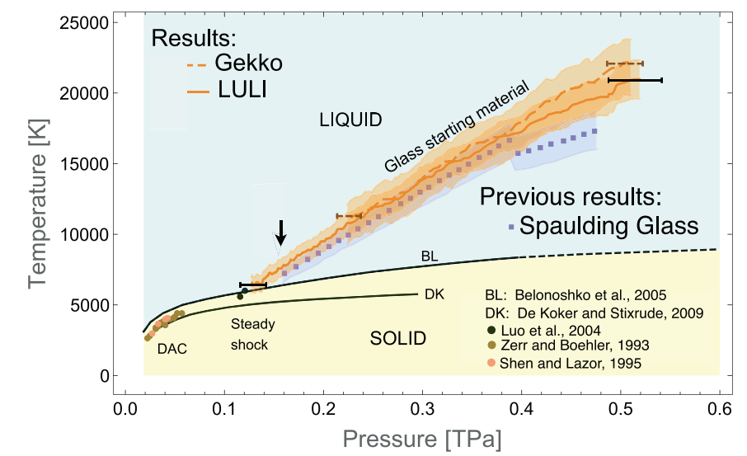
Equation of state of MgSiO₃
Fratanduono et al., PRB 2018
← Rankine Hugoniot
Bolis et al., PRB 2018
Gonzalez-Cataldo et al., PRB 2020

Slide 8


Hugoniot curve MgSiO₃
Gonzalez-Cataldo et al., PRB 2020

Slide 9

Hugoniot
curve MgSiO₃
Gonzalez-Cataldo et al., PRB 2020

Slide 10
Hugoniot
curve MgSiO₃
Gonzalez-Cataldo & Militzer, AIP Conf. Proc. 2020

Slide 11
Hugoniot curve MgSiO₃
Gonzalez-Cataldo & Militzer, AIP Conf. Proc. 2020

Slide 12
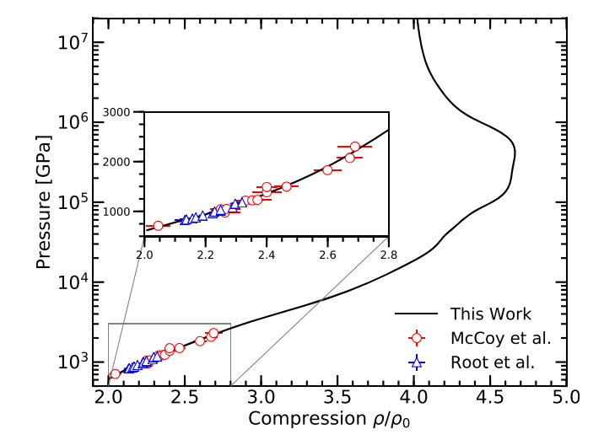
Hugoniot curve MgO
Soubiran et al., J. Chem. Phys. (2019)

Slide 13
OUTLINE
Motivation
Computational Techniques
  Path Integral Monte Carlo (PIMC)
  Density Functional Theory Molecular Dynamics (DFT-MD)
  EOS
Hugoniot curves
Ionization
Atomic structure
Conclusions and Implications

Slide 14
Ionization of K-shell (1s)
Nucleus-electron pair correlation function

Slide 15
No K-shell ionization at 10⁶ K
Atoms fully ionized at 30 x 10⁶ K

Slide 16


Grüneisen Parameter

Slide 17
OUTLINE
Motivation
Computational Techniques
  Path Integral Monte Carlo (PIMC)
  Density Functional Theory Molecular Dynamics (DFT-MD)
EOS and Hugoniot curves
Ionization
Atomic structure
Conclusions and Implications

Slide 18
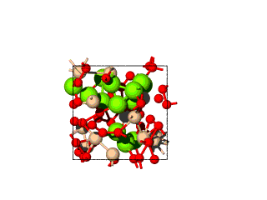
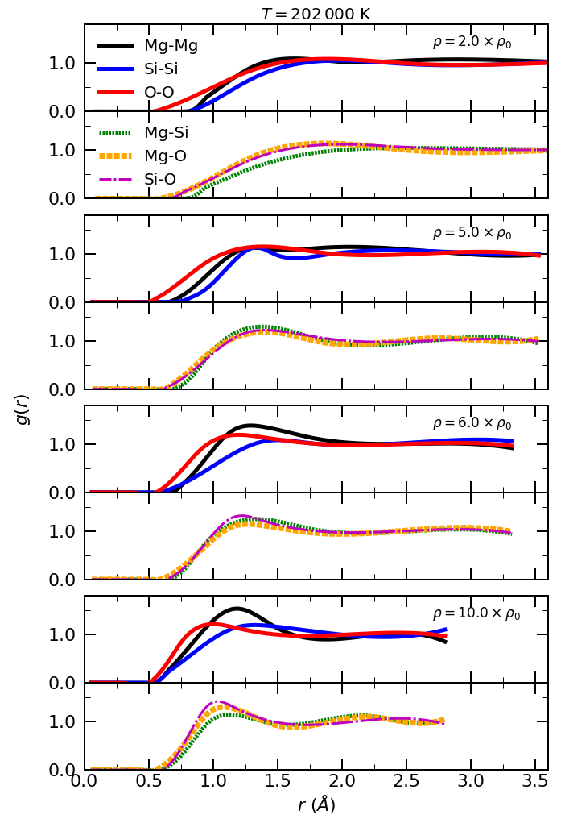
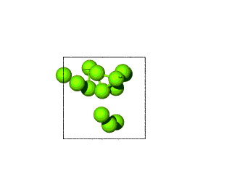
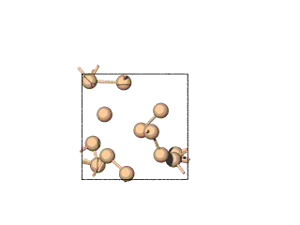
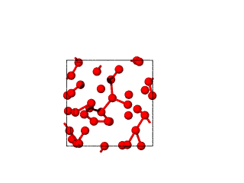
Radial
Distribution
Function

Slide 19
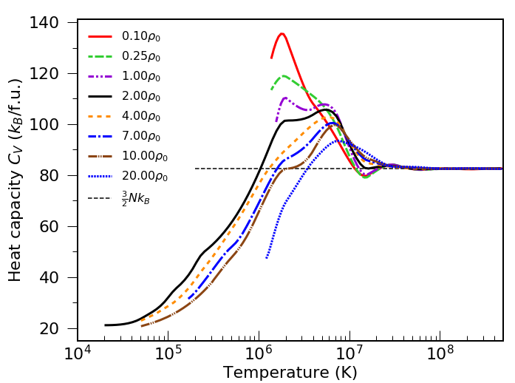

Slide 20
CONCLUSIONS
Consistent EOS of MgSiO₃ → PIMC+DFT (10⁴—10⁸ K, 6—65 g/cc )
→ Hydrodynamic codes
No ionization of the K-shell below 10⁶ K.
Grüneisen parameter does not depend on volume above 2x10⁶ K.
Principal Hugoniot consistent with experiments.
Hugoniot max. comp. ratio at 4.7-fold (15 g/cc):
P ~ 400 000 GPa, T ~ 5x10⁶ K.

Slide 21





Thanks!

Slide 22
Supplementary material

Slide 23
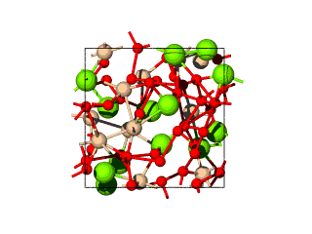
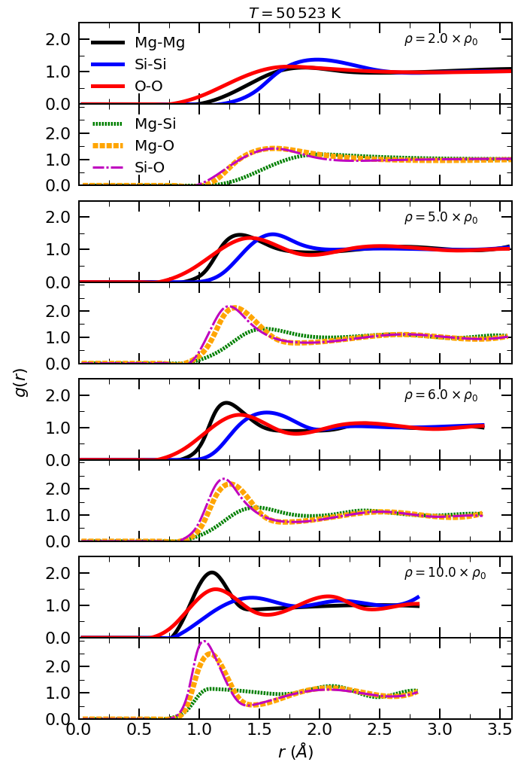
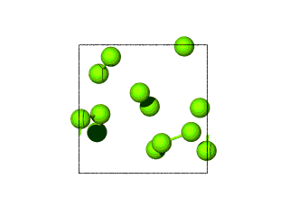
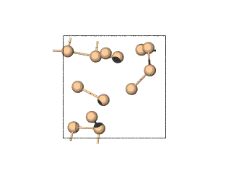
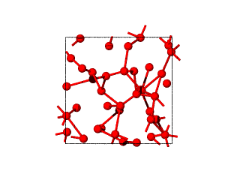
Radial
Distribution
Function

Slide 24



Grüneisen Parameter Derivation

